Slide 1
[ Gate Review #2 (’21.5.21 Fri 10:00~11:0) ]
Attendants
Kim Choonghan Yoon Byunjun
Park Chanho Kim Chiwon
Progress Achievements (5.3 ~ 5.14)
Future Plan (5.15 ~ 5.21)
-Comparing Base Models
1. Resnet
2. B0
3. B3
4. B5, B7
5. B5 BICUBIC
6. B5 CAR
14. ViT-B/16 BICUBIC
15. ViT-B/16 CAR
-Comparing Base Models
7. B5 Image add
8. B5 cutoff Aug(Aug Train data)
9. B5 RA Aug(Aug Train data)
10. B5 AA Aug(Aug Train data)
11. B5 cutoff Aug(Train + aug data)
12. B5 RA Aug(Train + aug data)
13. B5 AA Aug(Train + aug data)
16. ViT-B/16 Image add
17. ViT-B/16 cutoff Aug(Aug Train data)
18. ViT-B/16 RA Aug(Aug Train data)
19. ViT-B/16 AA Aug(Aug Train data)
20. ViT-B/16 cutoff Aug(Train + aug data)
21. ViT-B/16 RA Aug(Train + aug data)
22. ViT-B/16 AA Aug(Train + aug data)
+ B5 without pretrained
+Vit-B16 without pretrained
-Model Concatenation
Vit models. Top1 boosting. allocate different weights
-Study the key idea of architectures
Effinet, Vit, CAR
-Improved the performance
ViT-L/32 with AA no CAR 0.988 1st rank.
Issue Discussion
-Plotting loss function using log file( attached to train.py)
- use smoothing since our batch size is smaller than the base model. Epoch is fixed in 20.
- Change a learning rate from 0.01 to 0.0008, 0.0004 since our batch size is smaller than the base model.
-When we save the model’s parameters and csv file, please add model setting and your name into file’s name
When we make a presentation ppt, Suggest summary in 1st page.
-It is okay not to use RA. Because AA is based on RA.

Slide 2
# Attachments
Plan of Model Making
ResNet Base model
EffNet Model
b0 Model
b3 Model
b5 Model
ViT-B/16 Model
BICUBIC
BICUBIC
Super Resolution
Super Resolution
CAR
CAR
Augmentation
Augmentation
Aug train data
Train + aug data
Aug train data
Train + aug data
Cutoff
Cutoff
Cutoff
Cutoff
RA
RA
RA
RA
AA
AA
AA
AA
b7 Model + Fine Tuning Hyperparameters

Slide 3
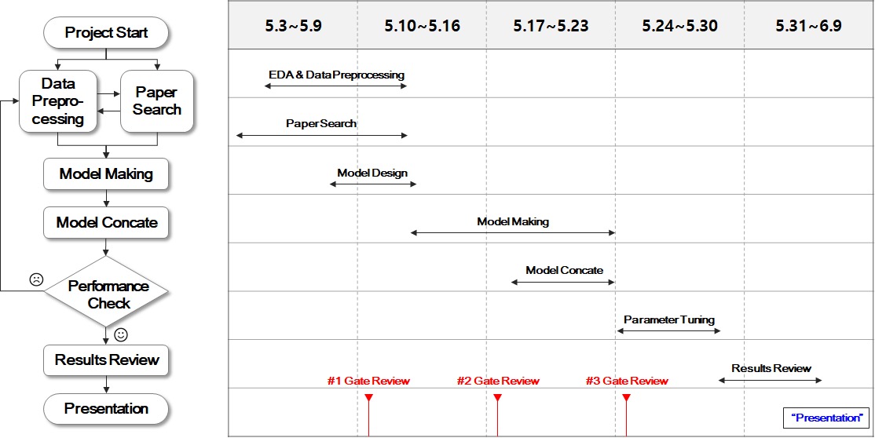
# Attachments

